Slide 1
Time series Analysis (ARIMA) with R
Barsha Saha

Slide 2
What is Time Series Data?
Collection of observations – repeated measurements over time
Observations are recorded at regular intervals for an entity –
Yearly, Monthly, Weekly → Business information, Sales, Turnover
Daily → Weather information
Hourly → Production line information
When multiple entities are observed over time → Panel Data = cross-sectional data + time series data
Objective: Understand the pattern of the time series data, select the best fit model and forecast

Slide 3
Components of Time Series Data
Trend
An overall increase or decrease observed in the data in long-term.
Seasonality
The variable is influenced by seasonal factors. Observed over a known period repeatedly. E.g. Higher sales in festive seasons.
Cyclicity
Distinct increasing and decreasing pattern in the data, but these are not of fixed period. E.g., Business cycles, but the length of the cycle is unknown

Slide 4
Time Series analysis with R
object <- ts(data, start, end, frequency)
ts() → Time series function
data → Data vector
start → first observation
end → last observation
frequency → interval between 2 recorded observations
For example,
frequency = 12 → Monthly data
frequency = 1 → Yearly data
frequency = 4 → Quarterly data

Slide 5
Components of Time Series Data
Trend
An overall increase or decrease observed in the data in long-term.
Seasonality
The variable is influenced by seasonal factors. Observed over a known period repeatedly. E.g. Higher sales in festive seasons.
Cyclicity
Distinct increasing and decreasing pattern in the data, but these are not of fixed period. E.g., Business cycles, but the length of the cycle is unknown

Slide 6
Objective: Exploratory Analysis
Convert the data into time series format
Decompose the data into time series components
Trend
Seasonality
Cyclicity
Time series analysis - methods

Slide 7
Methods of Time series analysis
Box-Jenkins multivariate model
Holt Winter exponential smoothening
ARIMA (Auto-regressive integrated moving-average)
Assumptions
Stationarity
Univariate Data
Objective
Model fit
Forecast

Slide 8
Objective: Exploratory Analysis
Convert the data into time series format
Decompose the data into time series components
Trend
Seasonality
Cyclicity
Test for core assumptions of ARIMA model

Slide 9
Assumptions
Stationarity
Properties of the time series do not depend on the time at which it is observed/recorded.
Statistically, a stationary process has mean, variance and auto-correlation structure that does not vary over time
In real world time series data – trend and seasonality contain the non-stationary component
Therefore, non-stationarity is removed prior to analysing the time series
Univariate
The time series contains only single variable observed in regular intervals

Slide 10
Objective: Exploratory Analysis
Convert the data into time series format
Decompose the data into time series components
Trend
Seasonality
Cyclicity
Test for core assumptions of ARIMA model
Remove non-stationarity – Trend and Seasonality

Slide 11
Objective: Model Fit
ARIMA model fit test
ACF (auto-correlation function) and PACF (partial auto-correlation function) plot
Determine type of model:
Auto-regressive AR
Moving-average MA
Auto-regressive moving-average ARMA
Auto-regressive integrated moving-average ARIMA

Slide 12
Objective: Model Fit
ARIMA model fit test
ACF (auto-correlation function) and PACF (partial auto-correlation function) plot
Model | ACF pattern | PACF pattern
Auto-regressive AR (p) | Exponential decay, Damped sine wave, or both | Significant spikes in first lags
Moving-average MA (q) | Significant spikes in first lags | Exponential decay, Damped sine wave
Auto-regressive moving-average ARMA(p,q) | Exponential decay from given lag | Exponential decay from given lag
Auto-regressive integrated moving-average ARIMA(p,d,q) | Same as above with differencing | Same as above with differencing

Slide 13
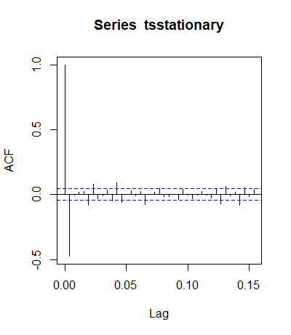
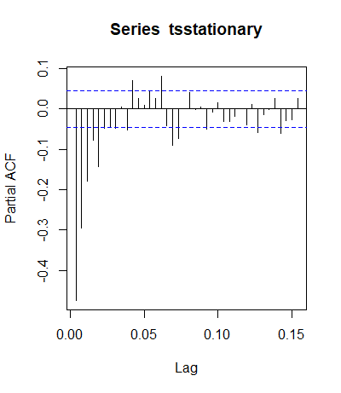
Objective: Model Fit
ARIMA model fit test
ACF and PACF plot
Basically an AR model

Slide 14
Objective: Forecast
Forecast future values
Based on the model defined in previous section

Slide 15
Thank You!

